Slide 1

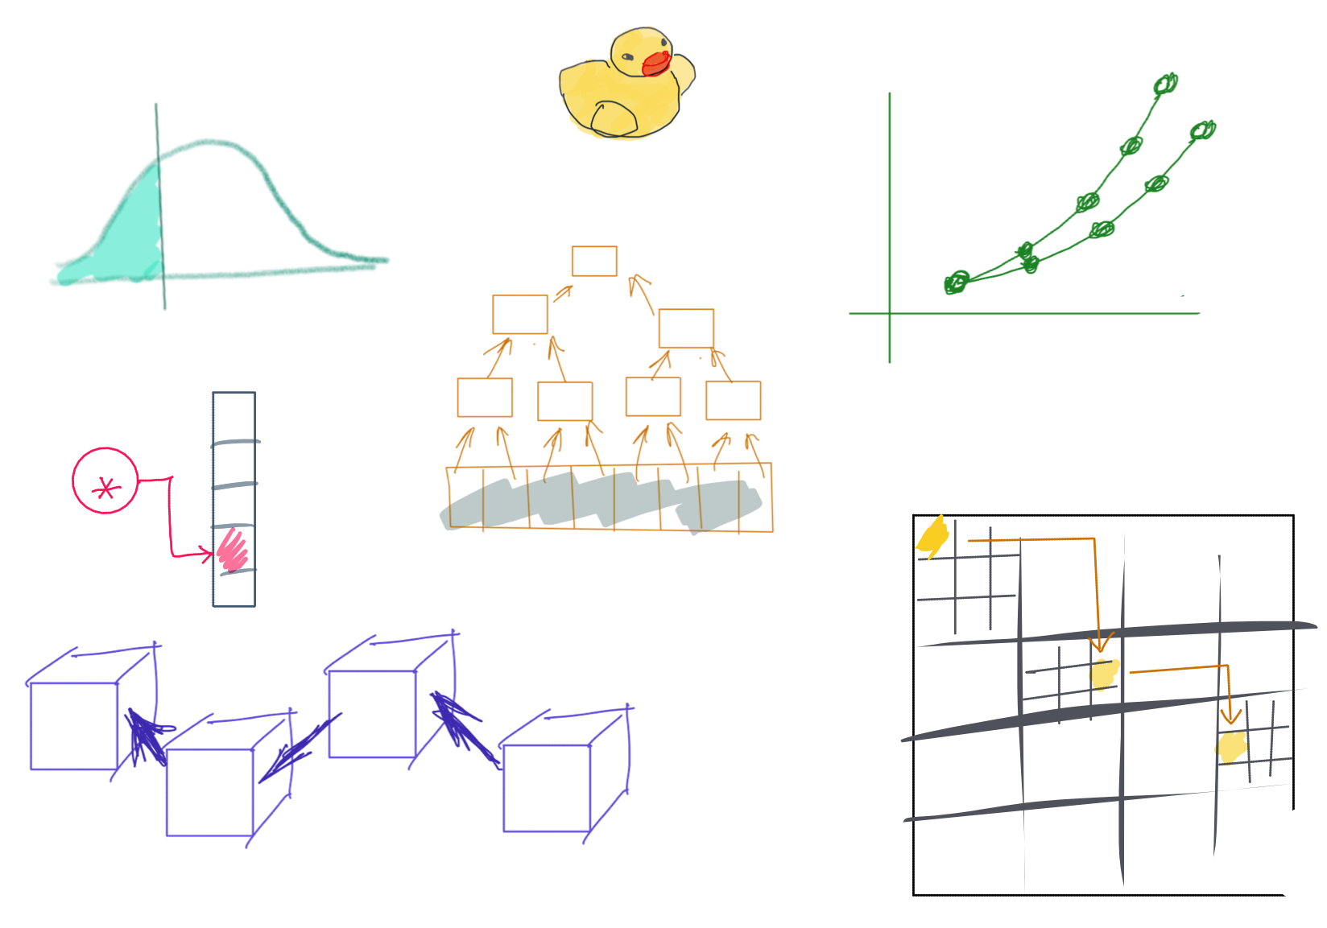

Slide 2
CSS342 Data Structures, Algorithms, and Discrete Mathematics (I)

Slide 3
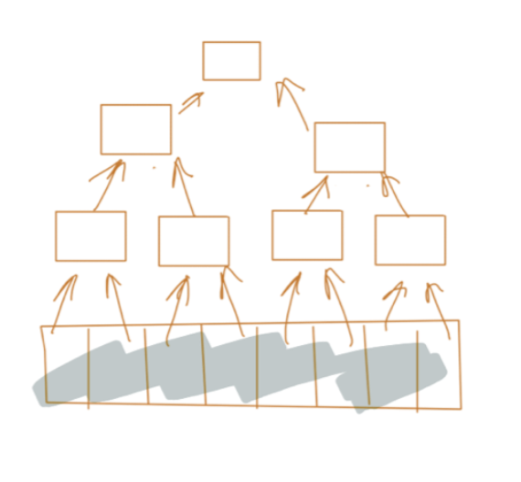
^{9th} Week Schedule
Wednesday
Binary Tree & Application
Homework 5 review
Quiz 3 review
Percentile Discussion
Friday
Guest lecture By Rick Web (Linkedin Bio)
Topics: C++ Smart Pointer & Rust programming language

Slide 4
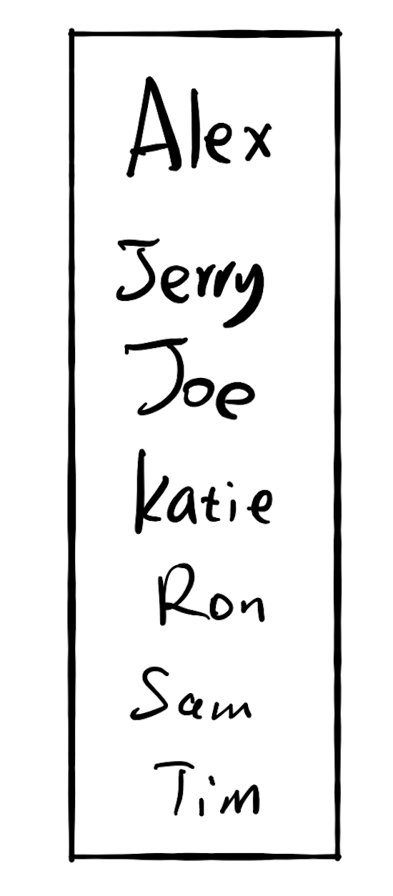
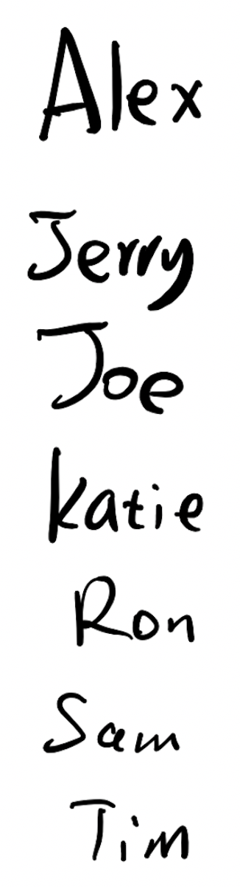
Fast for search
Slow for insertion
Slow for search
Fast for insertion

Slide 5
17.3 Do both fast?

Slide 6
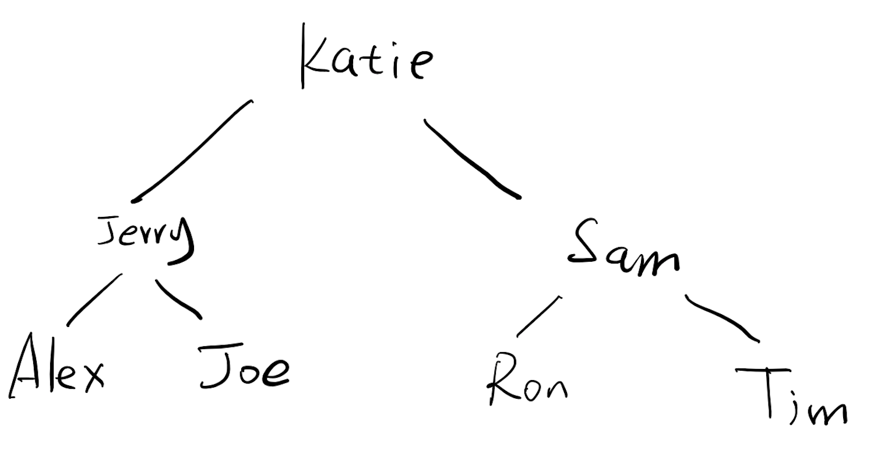
If there are 10,000 users
Each comparison takes 1 seconds
Each memory ops takes 2 seconds
Search the location:
13s
$$2s$$
Insertion:

Slide 7
A search problem
1
3
3
5
7
9
9
10
12
12
12
14
18
0
1
2
3
4
5
6
7
8
9
3
9
12
9
3
12
1
5
10
14
7
12
18

Slide 8
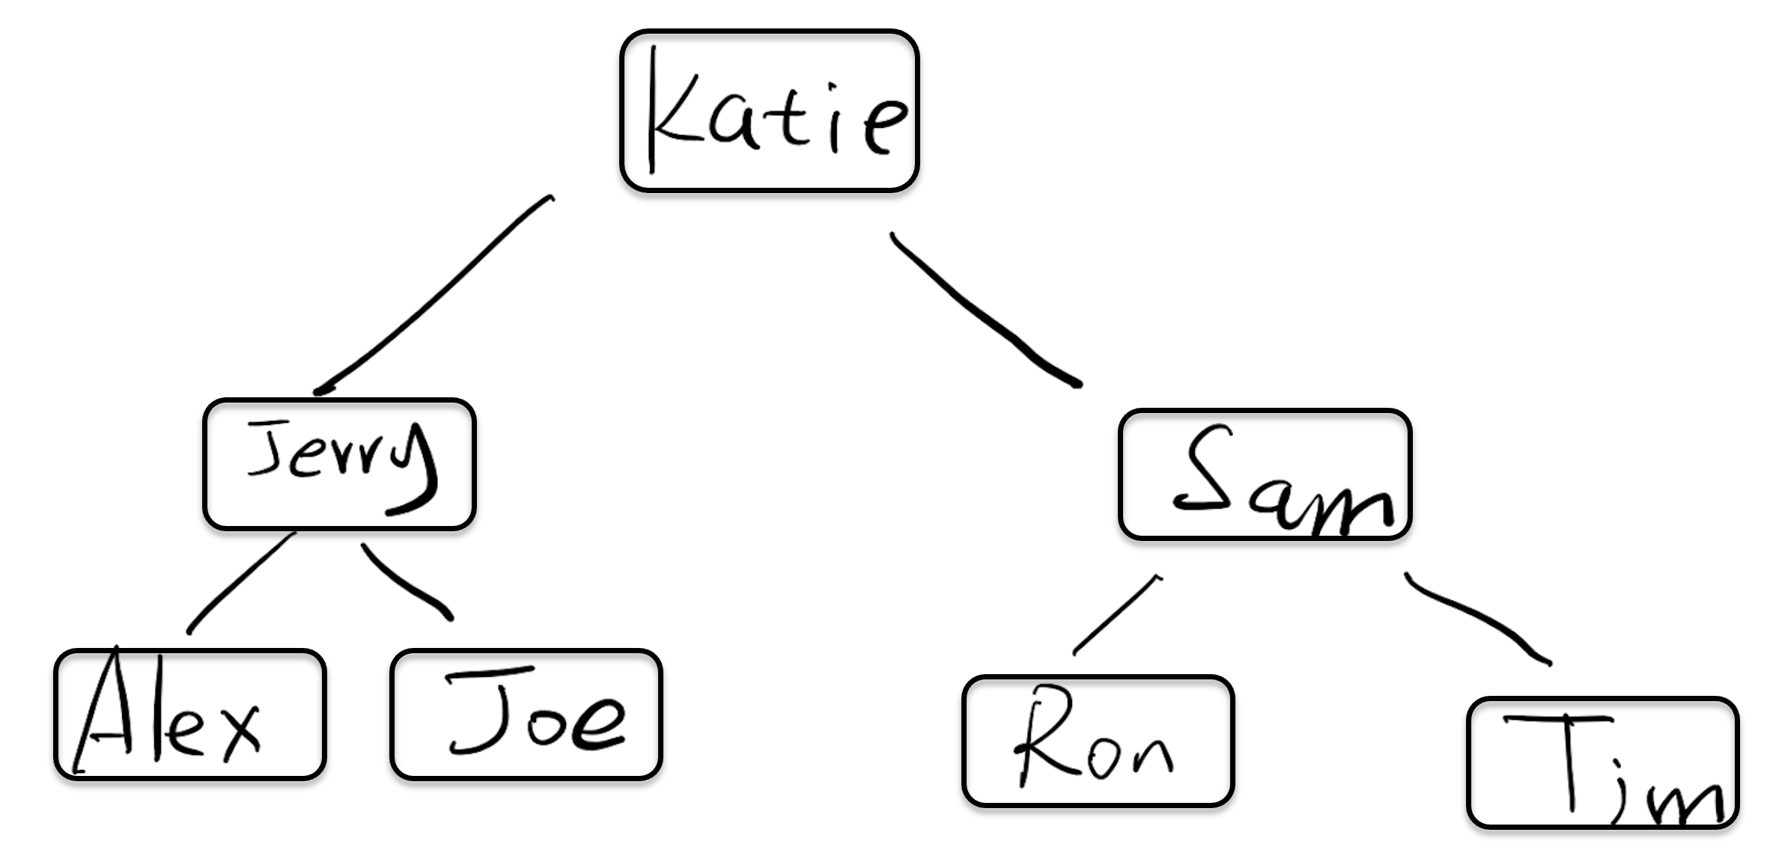
How do we implement this?

Slide 9
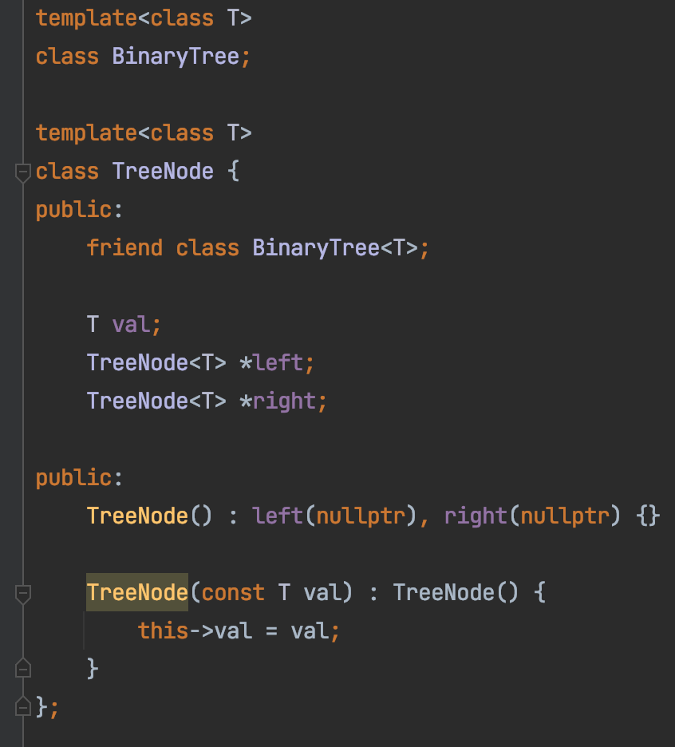

Slide 10
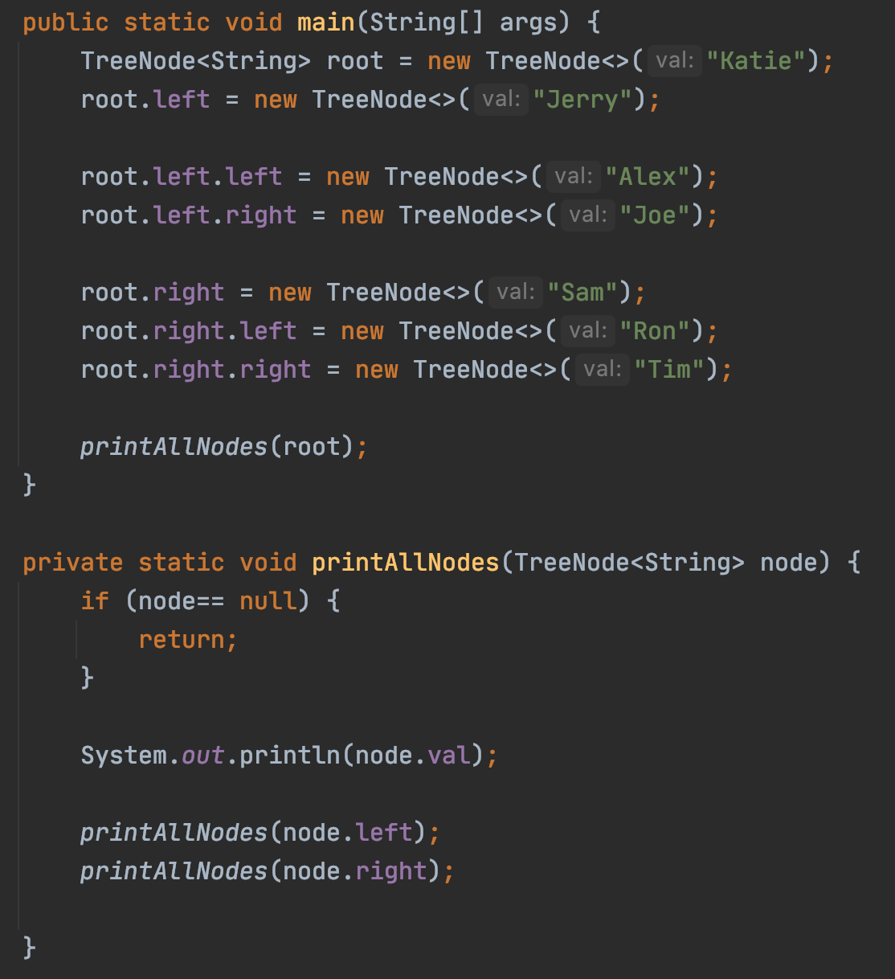
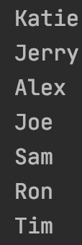

Slide 11
Binary Search Tree
A Binary Search Tree (BST) :
all the nodes follow the below-mentioned properties:
The left sub-tree of a node has a key less than or equal to its parent node's key.
The right sub-tree of a node has a key greater than to its parent node's key.

Slide 12
Exercise
Is this a binary search tree?
8
3
10
14
1
6
4
7

Slide 13
Exercise
Is this a binary search tree?
8
3
10
11
14
1
6
4
7

Slide 14
Exercise
Is this a binary search tree?
8
3
1
6
4
7

Slide 15
Exercise
Is this a binary search tree?
2
3
5
7
6
9

Slide 16

Demo
https://github.com/a-teaching-goose/2022-342-code-along/tree/2022-05-20

Slide 17
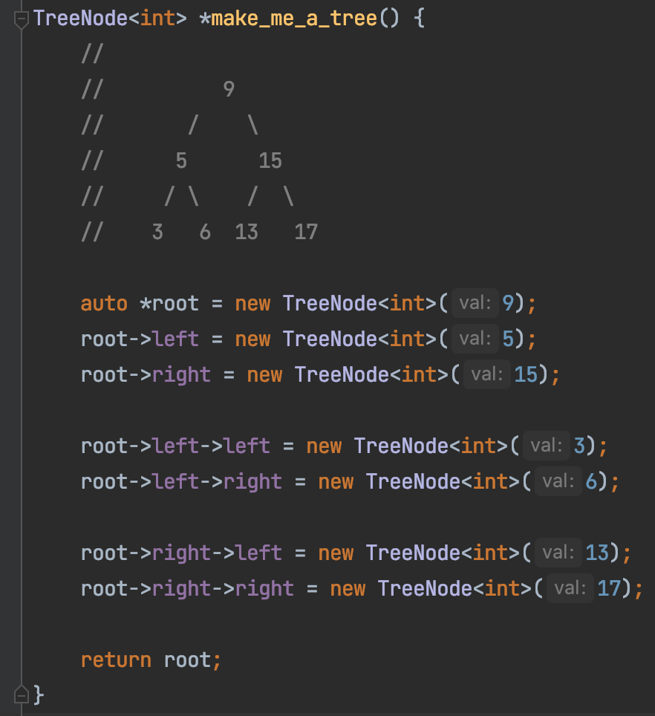
Build A BST

Slide 18
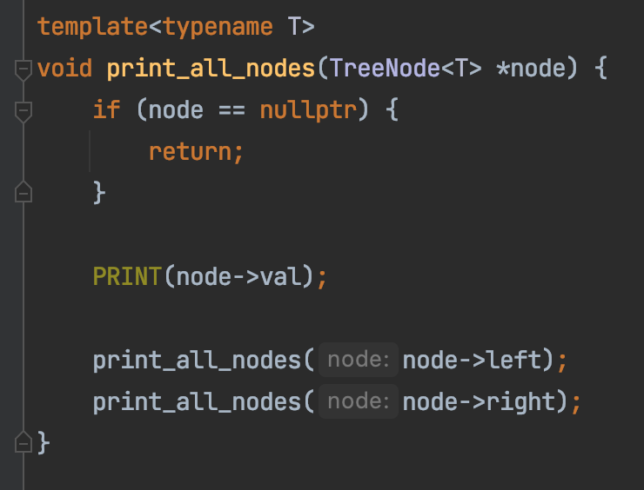
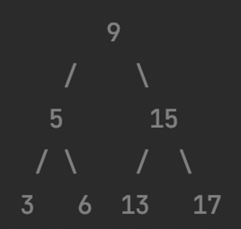
Print A BST

Slide 19
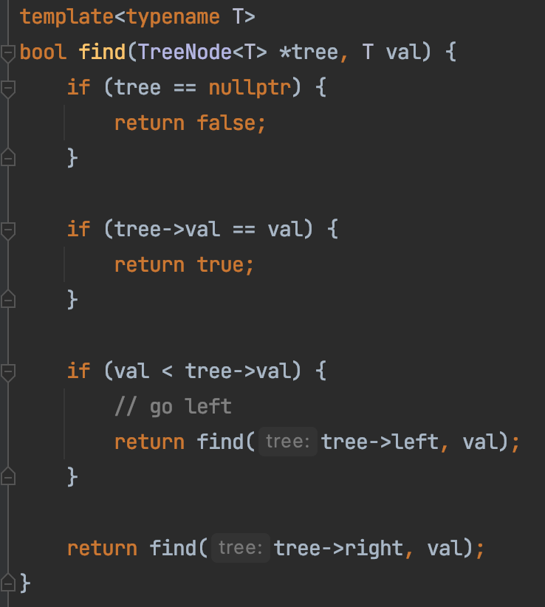
Search In A BST

Slide 20
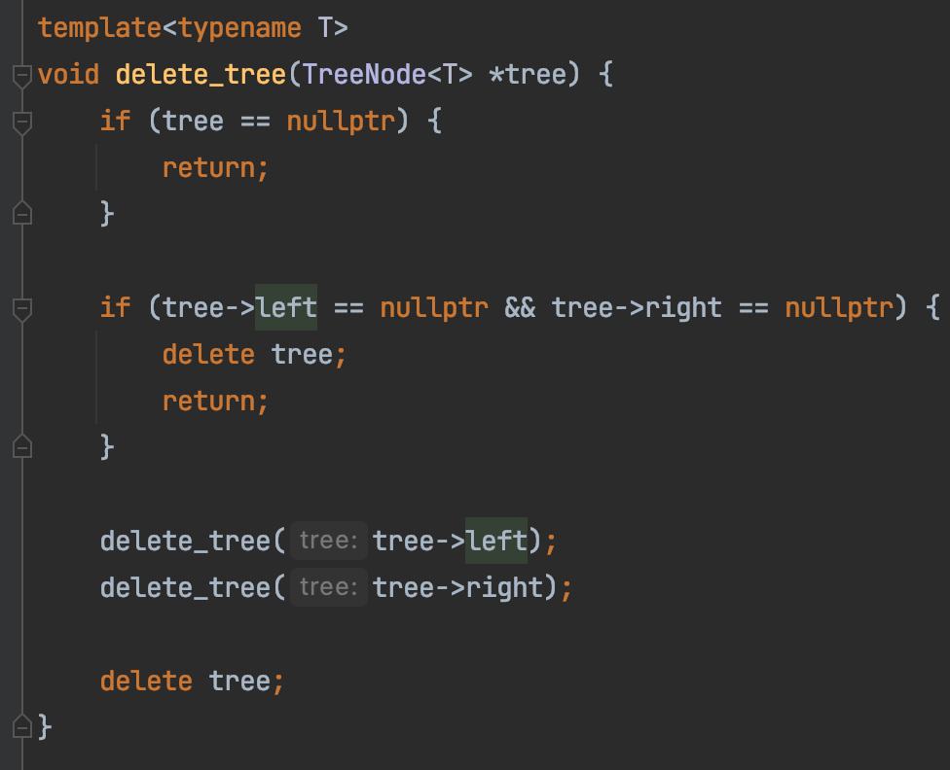
Delete A BST

Slide 21
Application of Tree: Search in a dataset
id
name
age
Search by id?
0
Sam
40
1
Bob
25
Search by name?
2
Katie
33
3
Ron
10
4
Tim
45
Search by age?
5
Alan
55
…
…
…
…
…
…

Slide 22
Application of Tree: Search in a dataset
id
name
age
0
Sam
40
Search by id ?
1
Bob
25
2
Katie
33
3
Ron
10
Find one with id 3
4
Tim
45
5
Sam
20
…
…
…
…
…
…

Slide 23
Application of Tree: Search in a dataset
id
name
age
0
Sam
40
Search by name ?
1
Bob
25
2
Katie
33
Index
(cache)
3
Ron
10
Find all with name “Sam”
4
Tim
45
5
Sam
20
A name Index
…
…
…
…
…
…

Slide 24
Application of Tree: Search in a dataset
id
name
age
0
Sam
40
Search by Age ?
1
Bob
25
2
Katie
33
Index
(cache)
3
Ron
25
Find all with age 25
4
Tim
45
5
Sam
20
A age Index
…
…
…
…
…
…

Slide 25
Application of Tree: Search in a dataset
Name Index
id
name
age
Find all with name “Sam”
0
Sam
40
1
Bob
25
2
Katie
33
Age Index
3
Ron
25
Find all with age 25
4
Tim
45
5
Sam
20
…
…
…
…
…
…

Slide 26
Application of Tree: Search in a dataset
Name Index
id
name
age
0
Sam
40
1
Bob
25
2
Katie
33
name> a set of id with the given name
3
Ron
25
HashTable
4
Tim
45
5
Sam
20
Binary Search Tree
…
…
…
…
…
…

Slide 27
Application of Tree: Search in a dataset
Age Index
id
name
age
0
Sam
40
1
Bob
25
2
Katie
33
age-> a set of id with the given age
3
Ron
25
HashTable
4
Tim
45
5
Sam
20
Binary Search Tree
…
…
…
…
…
…

Slide 28
Application of Tree: Search in a dataset
id
name
age
HashTable
0
Sam
40
1
Bob
25
2
Katie
33
Binary Search Tree
3
Ron
25
4
Tim
45
B Tree
5
Sam
20
…
…
…
…
…
…

Slide 29
Application of Tree: Search in a dataset
id
name
age
HashTable
0
Sam
40
1
Bob
25
2
Katie
33
Binary Search Tree
3
Ron
25
4
Tim
45
B Tree
5
Sam
20
…
…
…
…
…
…

Slide 30

Tree Traversal
Visit each node of a tree
1
1
2
2
7

Slide 31
Binary Tree Traversal
Pre-order: root, left, right
3
1
1
5
2
7
2
7
8
1, 2, 7
3, 1, 2, 7, 5, 8

Slide 32
Exercise
What’s the pre-order traversal of this tree?
8
3
10
9
14
1
6
4
7

Slide 33
Code it up!
preorder: Root, Left, Right
Recursion
Middle node value
Preorder(left subtree)
Preorder(right subtree)
Subproblem?
Stopping condition?
Node == null

Slide 34
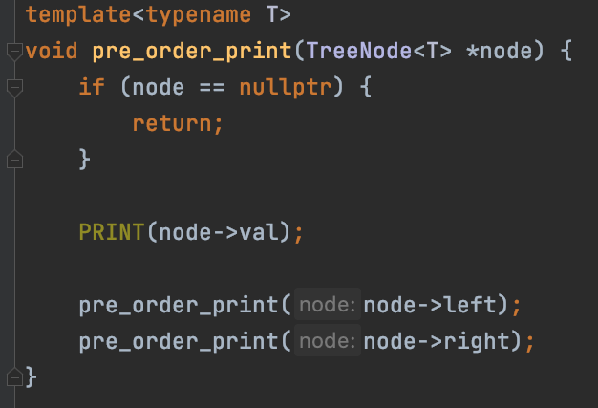
preorder: Root, Left, Right
Recursion

Slide 35
preorder: Root, Left, Right
Iterative
(without recursion)
3
2
4
Result (List):
3
2
4
Stack:
4
2

Slide 36
preorder: Root, Left, Right
Iterative
(without recursion)
While stack not empty {
3
Pop a node from Stack
Add middle node to result list
2
4
Push right node to Stack if any
Push left node to Stack if any
}

Slide 37
preorder: Root, Left, Right
Iterative
(without recursion)
While stack not empty {
Pop a node from Stack
Add middle node to result list
Push right node to Stack if any
Push left node to Stack if any
}

Slide 38
Pre-order Application
Target: 14
Search in a BST
?
9
9
?
3
12
1
5
10
14
?
14
7
12
18
Top down
Preorder

Slide 39
Binary Tree Traversal
In-order: left, root, right
3
1
1
5
2
7
2
7
8
2, 1, 7
2, 1, 7, 3, 8, 5

Slide 40
Exercise
What’s the inorder traversal of this tree?
8
3
10
9
14
1
6
4
7
In: 1, 3, 4, 7, 6, 8, 9, 10, 14
In: 1, 3, 4, 6, 7, 8, 9, 10, 14

Slide 41
Code it up!
inorder: Left, Root, Right
Recursion
Inorder(left subtree)
Middle node value
Inorder(right subtree)
Subproblem?
Stopping condition?
Node == null

Slide 42
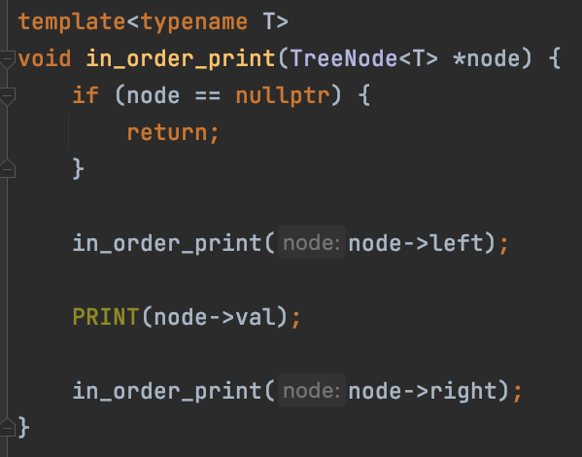
inorder: Left, Root, Right
Recursion

Slide 43
Binary Tree Traversal
Post-order: left, right, root
3
1
1
5
2
7
2
7
8
2, 7, 1
2, 7, 1, 8, 5, 3

Slide 44
Exercise
What’s the postorder traversal of this tree?
8
3
10
2
14
1
6
4
7

Slide 45
Code it up!
postorder: Left, Right, Root
Recursion
Postorder(left subtree)
Postorder(right subtree)
Middle node value
Subproblem?
Stopping condition?
Node == null

Slide 46
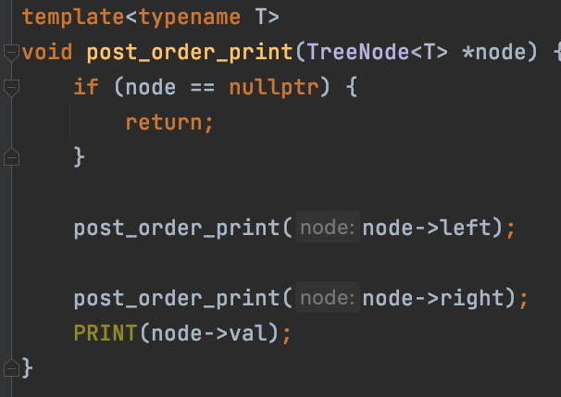
postorder: Root, Left, Right
Recursion

Slide 47
Homework 5 Review
Reverse Linked List With Recursion
A TALE OF TWO SINGLE LINKED LIST REVERSALS
CSS342

Slide 48
Homework 5 Review
Stack Top
0
Reverse A stack
1
2
3
Stack Bottom

Slide 49

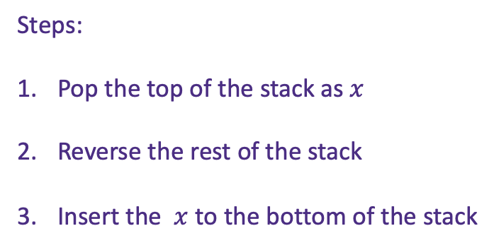
Homework 5 Review
0
1
2
3
Reverse A stack
0
Steps:
Pop the top of the stack as $x$
Reverse the rest of the stack
Insert the $x$ to the bottom of the stack
3
2
1
3
2
1
0

Slide 50
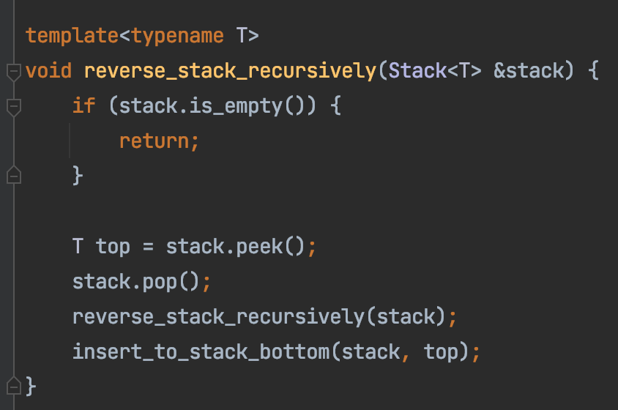
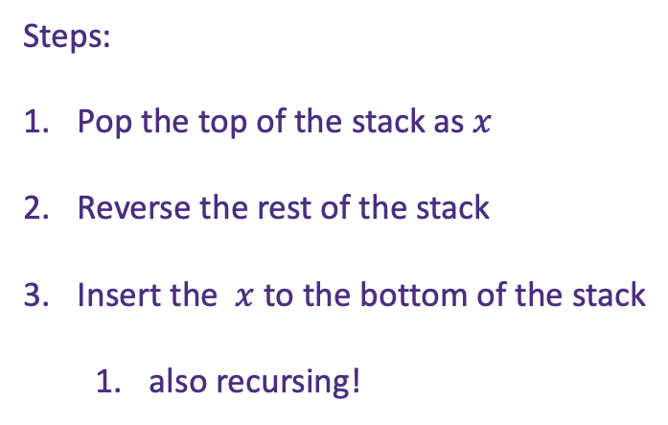
Homework 5 Review
0
1
Reverse A stack
2
3
Steps:
Pop the top of the stack as $x$
Reverse the rest of the stack
Insert the $x$ to the bottom of the stack
also recursing!

Slide 51
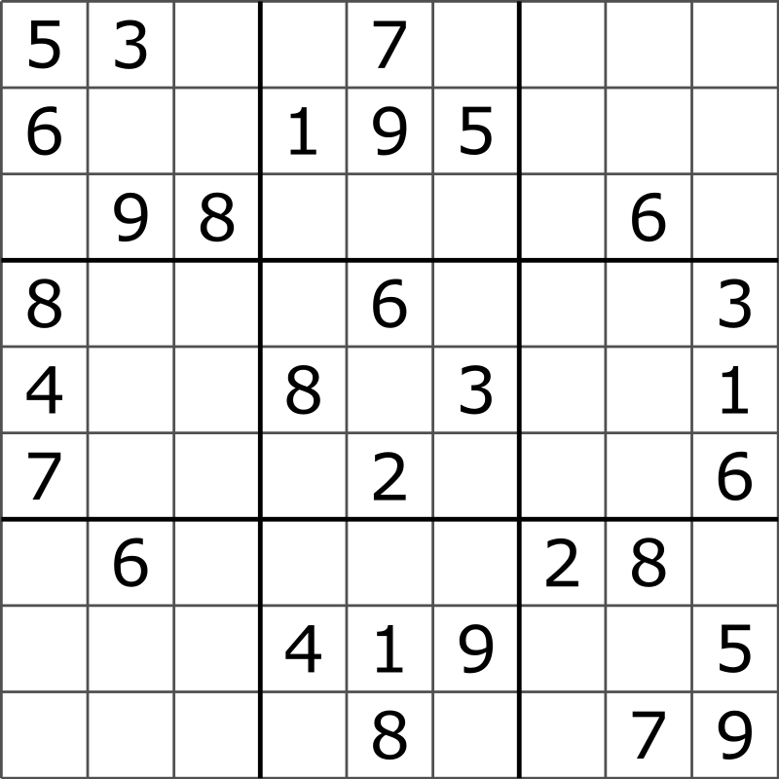
Homework 5 Review
Sudoku

Slide 52
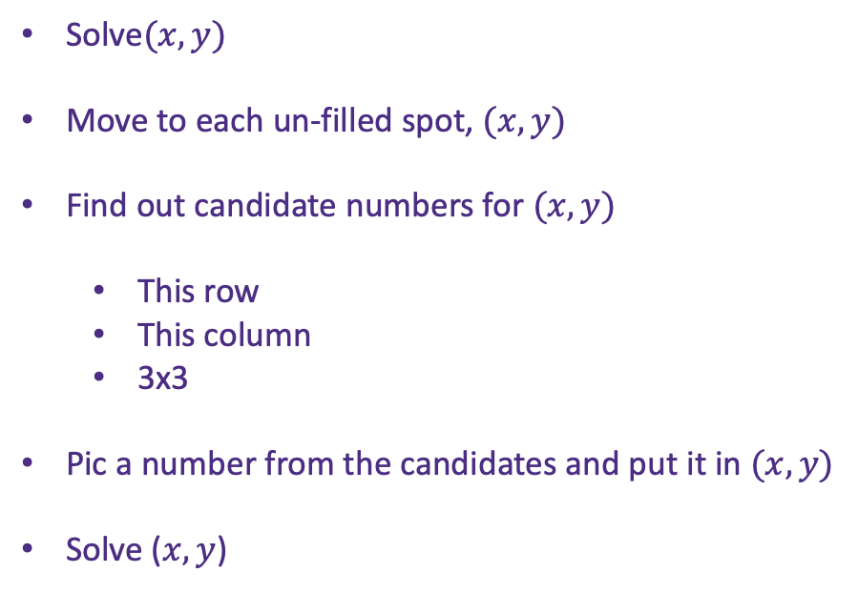
Homework 5 Review
Sudoku
Solve$(x,y)$
Move to each un-filled spot, $(x,y)$
Find out candidate numbers for $(x,y)$
This row
This column
3x3
Pic a number from the candidates and put it in $(x,y)$
Solve ($x,y$)

Slide 53
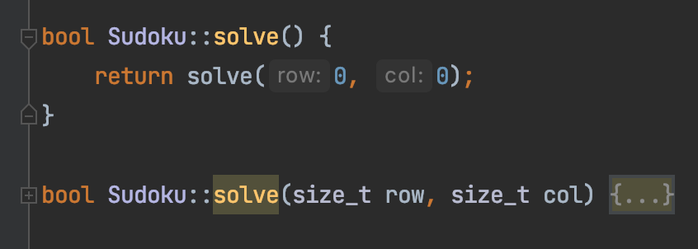
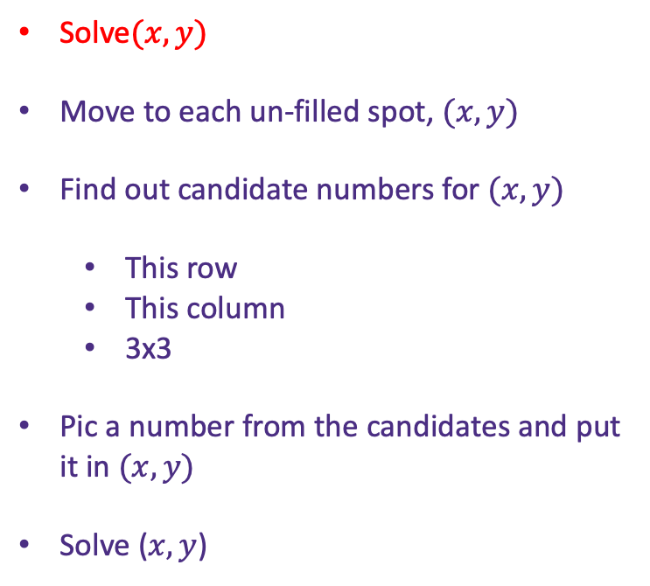
Homework 5 Review
Sudoku
Solve$(x,y)$
Move to each un-filled spot, $(x,y)$
Find out candidate numbers for $(x,y)$
This row
This column
3x3
Pic a number from the candidates and put it in $(x,y)$
Solve ($x,y$)

Slide 54
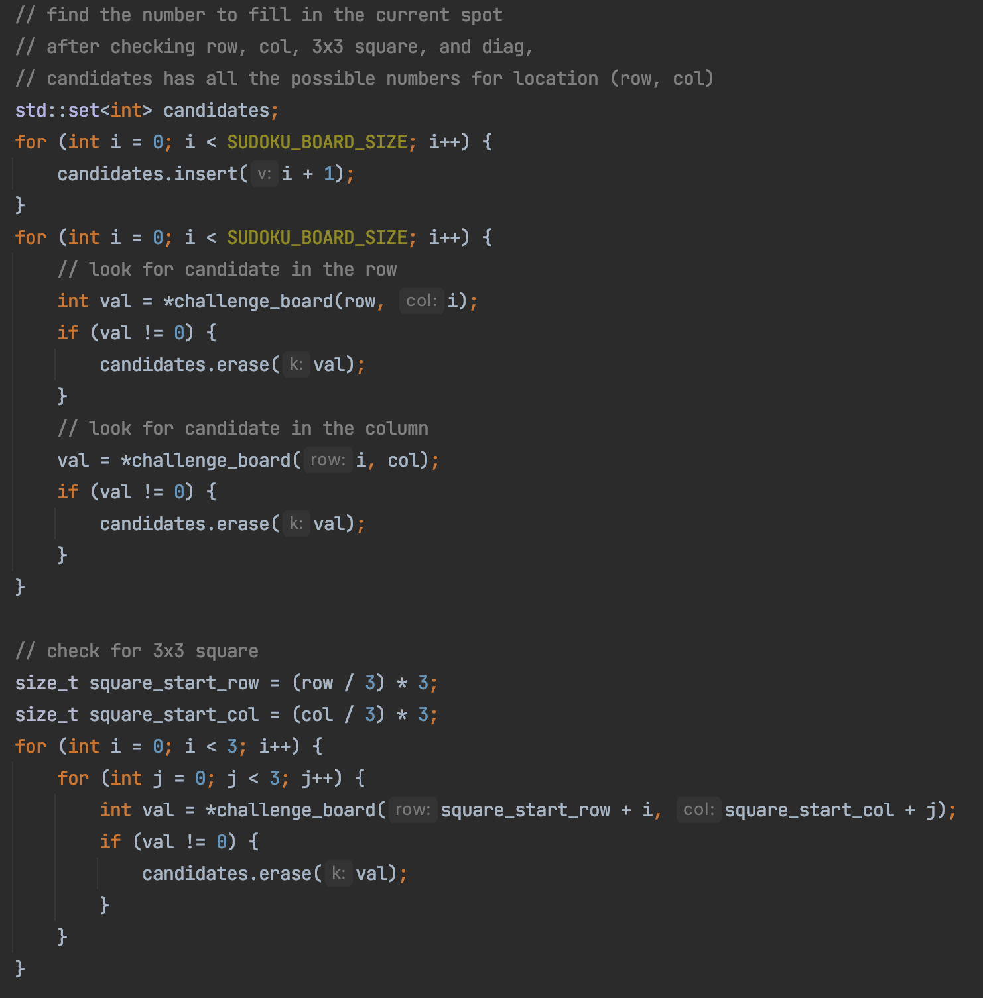
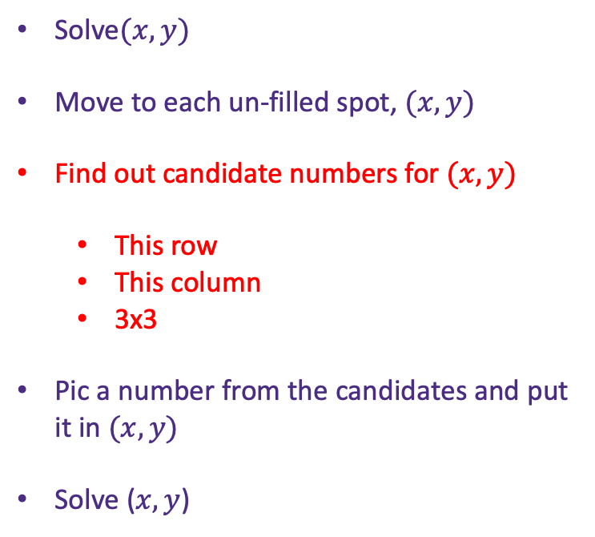

Homework 5 Review
Sudoku
Inside Solve$(x,y)$
Solve$(x,y)$
Move to each un-filled spot, $(x,y)$
Find out candidate numbers for $(x,y)$
This row
This column
3x3
Pic a number from the candidates and put it in $(x,y)$
Solve ($x,y$)

Slide 55
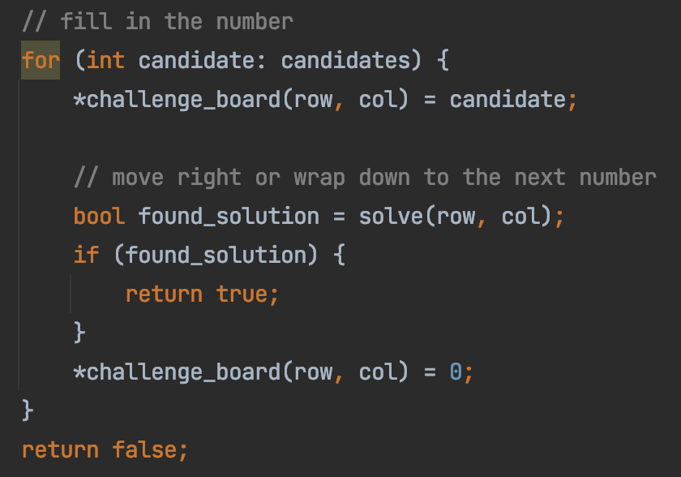
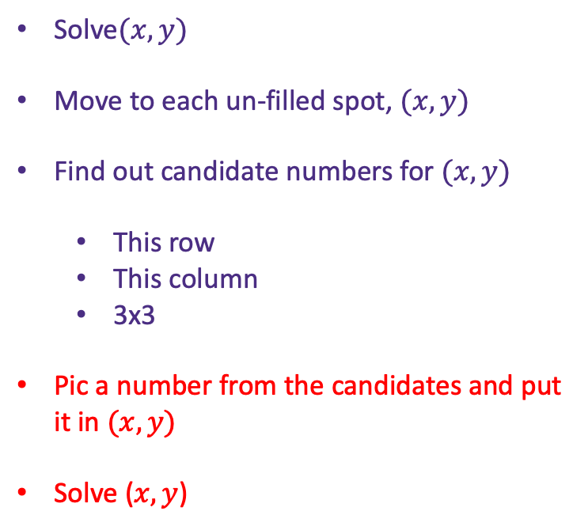

Homework 5 Review
Sudoku
Solve$(x,y)$
Move to each un-filled spot, $(x,y)$
Find out candidate numbers for $(x,y)$
This row
This column
3x3
Pic a number from the candidates and put it in $(x,y)$
Solve ($x,y$)
Inside Solve$(x,y)$

Slide 56
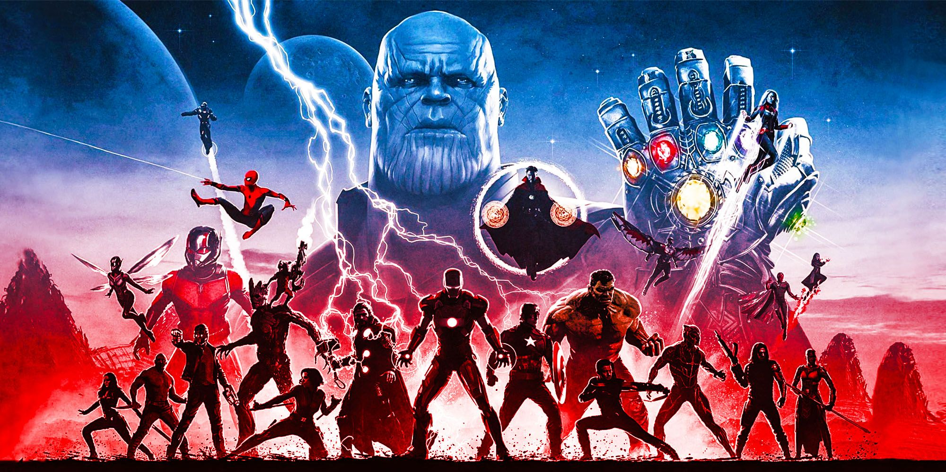
Schedule – Endgame

Slide 57
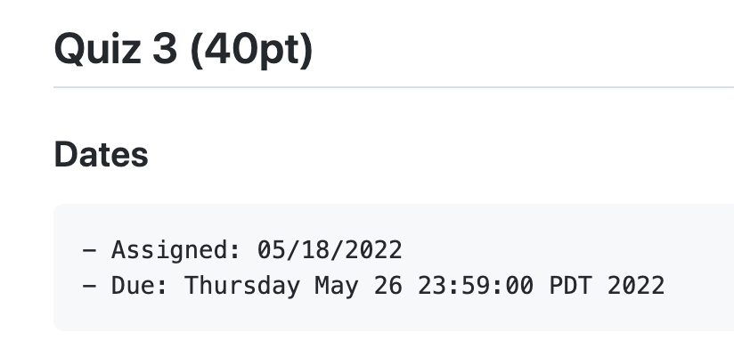
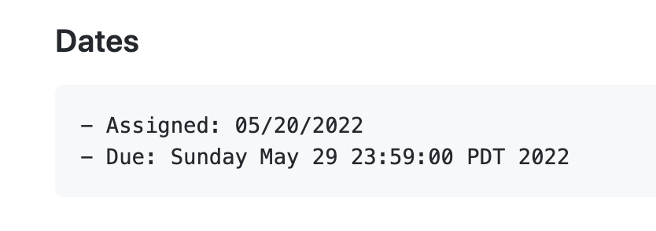
Schedule
Final-homework/project
To be release on Monday (5/30)
3 problems
2 regular (1 recursion + 1 tree)
1 extra credit for homework
1 has 60pt of final exam
Due 6/10 (2 days after final)
Final-exam
6/8 (Wednesday) during lecture time
40pts (the other 60 in the final project)
Same format as midterm
Comprehensive (everything)
Homework 5

Slide 58

Schedule
Final-homework/project
To be release on Monday (5/30)
3 problems
2 regular (1 recursion + 1 tree)
1 extra credit for homework
1 has 60pt of final exam
Due 6/10 (2 days after final)
Final-exam
6/8 (Wednesday) during lecture time
40pts (the other 60 in the final project)
Same format as midterm
Comprehensive (everything)
25
29
31
8
10
Today
hw5 due
Final exam
Final hw due

